Slide 1

By Andrew Gillis

Slide 2
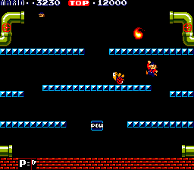
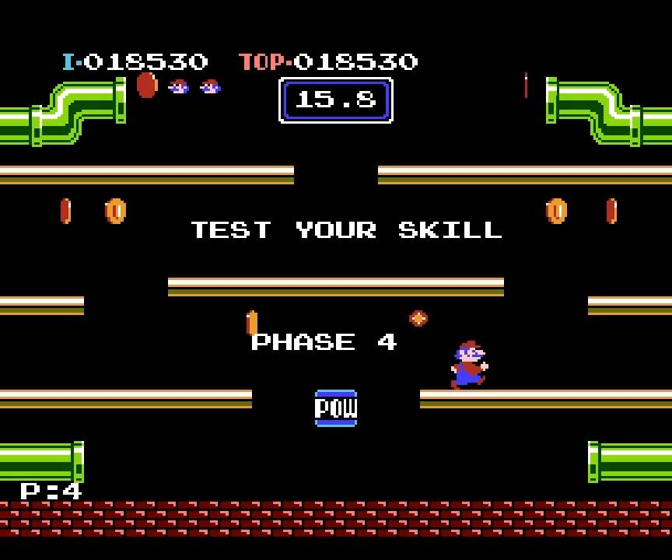
Overview of how to play the original 1983 Mario Bros.
Can support two players
The game is played on the same 4 layer platform formation with the blocks changing color depending on the phase
The game has two different phase types regular play and test your skill
Regular play: the player must destroy all enemies, by jumping underneath a platform the needed number of times, to get to the next phase. Players may choose to use the pow to hit all enemies, twice.
Test Your Skill: randomly between each regular play phase a coin collection game is played with a set amount of time that gets shorter depending on the number of the phase.

Slide 3

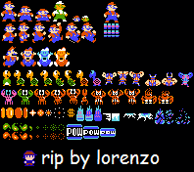
Player Interaction
Lives
Has three lives and there is no way of gaining health back
Damaging Action
Jumping under a enemy will damage the enemy causing their state to change
Pow
Does a damagining action to all enemies once

Slide 4
Types of enemies
Common Destroyable
Shellcreeper
Can range on varying colors depending on the amount of lives it has
Does not move when damaged
If damaging action is used while turned over it flips over and returns to full lives plus one
Sidestepper
Same as shellcreeper except it moves when damaged
Fighterfly
Can fly allowing it to hit the floor less often making the damaging action harder to enact
Slipice
Will not be implemented due to it not appearing until level 11
Fireball
Cannot be destroyed and does not count toward enemy count in order to win level
Rare (will not be implemented )
Common Invincible

Slide 5

Enemy Interaction with Environment
All enemies come out of the pipe at the top of the screen and recycle through the bottom pipe, arriving back at the top pipe with the same state as before
All enemies will continue moving in the same direction until hitting a wall or if its a sidestepper, another sidestepper

Slide 6
Class Diagrams
Enemy
Environment
Player
+location()
+currDirection()
+flipDirection()
+recycle()
___________________________
-type
-state
-texture
-lives
-destructable
+bounds
_____________________________
- powLife
- phase
- type
- blockColor
+jump()
+right()
+left()
+location()
_____________________________
- lives
-score

